Slide 1

Industry and Company Background
By: Venkat Gopalakrishnan, Justin Kroenert, Ashish Mahadik, Dan Olmsted, Sammazo Plamin, Anupriya Thirumurthy
Prepared For: Roger Moore , CFO
July 14, 2018

Slide 2
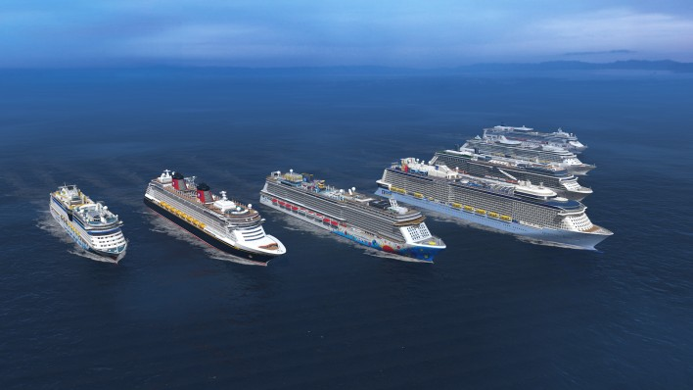
Agenda
Industry
Company
Customers
Competitors
Conclusion

Slide 3
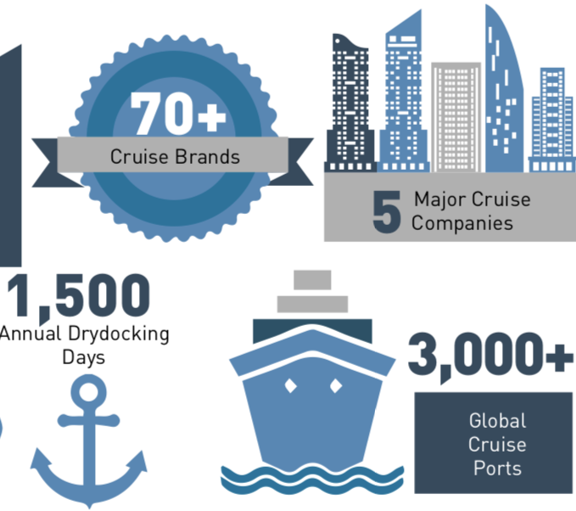
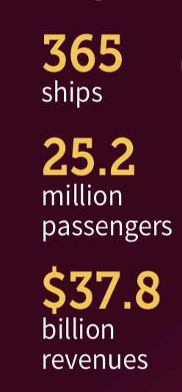
The Cruise Industry - In a Nutshell
The cruise industry comprises of 70 plus cruise brands.
Characterized by 5 Major Cruise companies
Carnival Corporation
Royal Caribbean
Norwegian Cruise Line
MSC Cruises
Genting
An estimate of 1500 drydocking days on an annual basis, with an annual spend of $2million per day a vessel is in drydock, amounting to a $3billion annual spend.
Company
Customers
Competitors
Industry
Conclusion

Slide 4
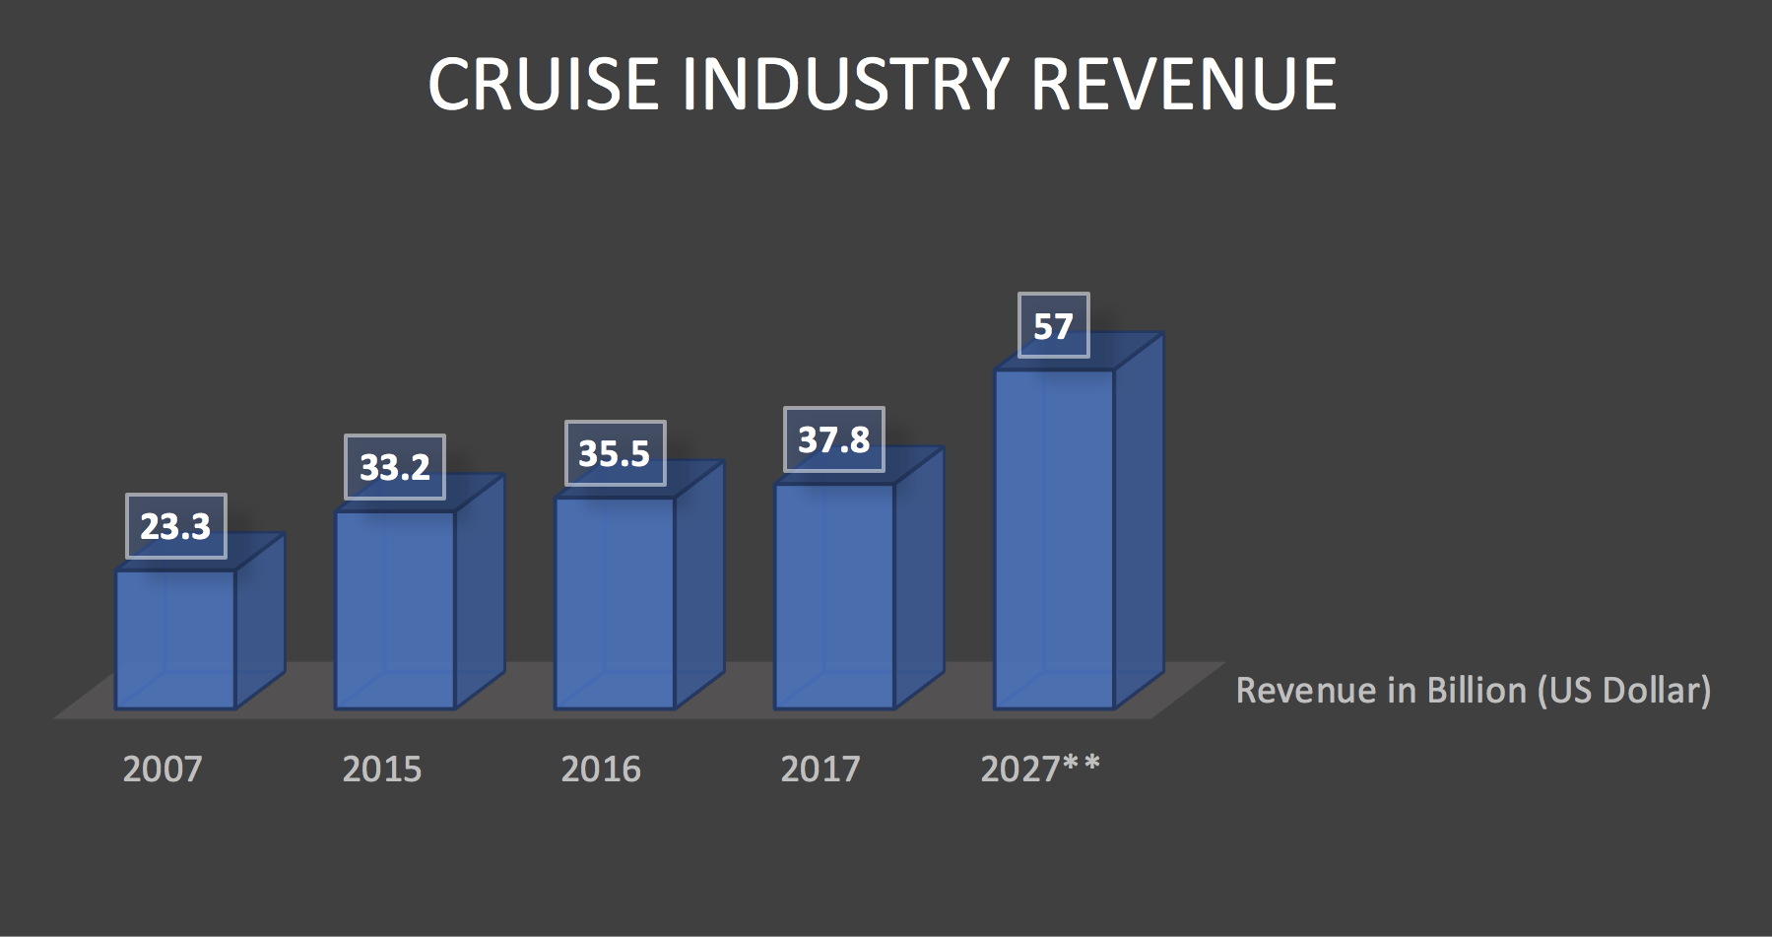
Growth of the Industry
INDUSTRY REVENUE
$57 billion in 2027
Company
Customers
Competitors
Industry
Conclusion

Slide 5
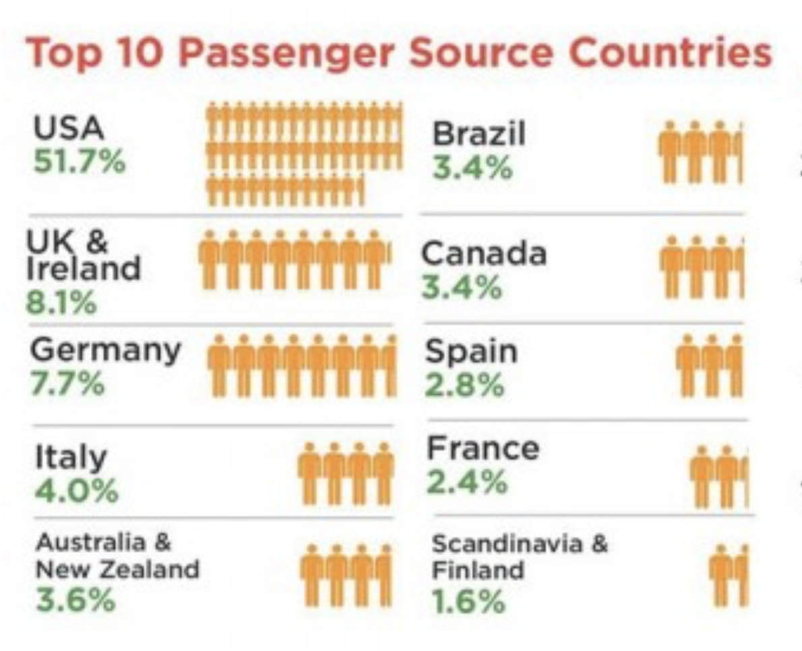
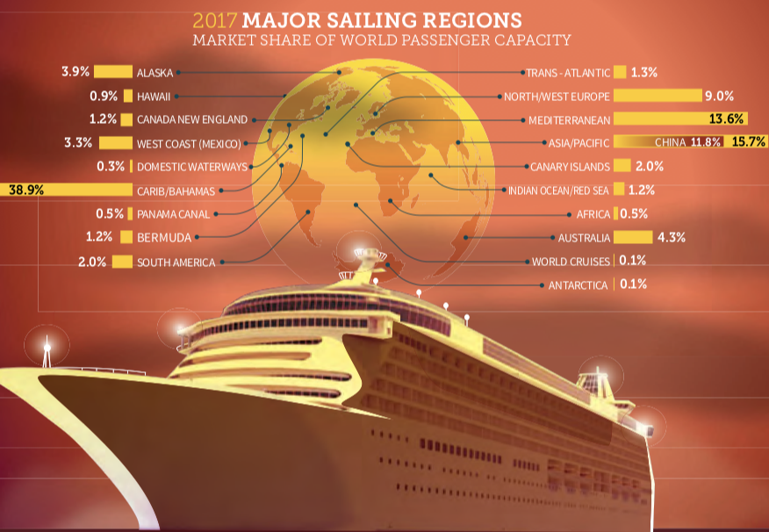
Industry Trends
Company
Customers
Competitors
Industry
Conclusion

Slide 6
Company Information
Started in 1968 by Norwegian shipping companies
Song of Norway - First Ship(1970-1997)
Vision- To deliver the best vacation experience
Mission- anticipate the needs of customers, provide service with a friendly greeting and a smile.
Company
Customers
Competitors
Industry
Conclusion

Slide 7

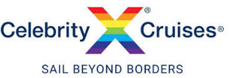




Company Subsidiaries
Since 1969,25 Ships,77 Countries, 6 Continents, 100% Ownership
Since 1997,12 Ships,7 Continents,100% Ownership
Since 2007, 2 Ships, Spanish Culture , 100% Ownership
Since 2009,7 Ships, German culture, 50% Ownership
Since 2015,1 Ship, Chinese Culture, 36% Ownership
Since 2006 , 4 Ships , Spanish Culture, 49% Ownership
Company
Customers
Competitors
Industry
Conclusion

Slide 8
Value Chain
Company
Customers
Competitors
Industry
Conclusion

Slide 9
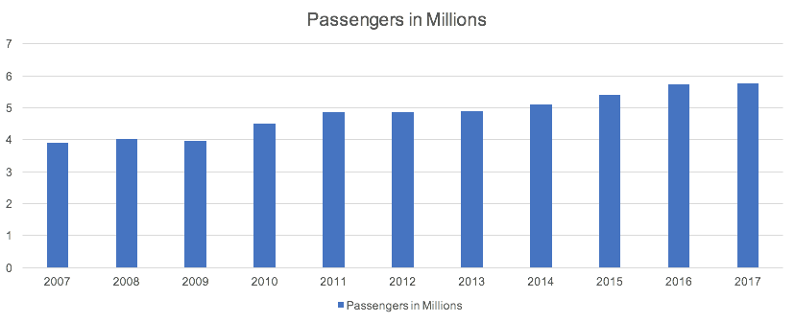
Passenger Statistics
Company
Customers
Competitors
Industry
Conclusion

Slide 10
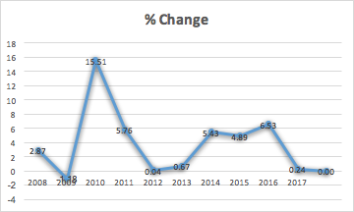
Passenger statistics (continued)
Company
Customers
Competitors
Industry
Conclusion

Slide 11
Revenue per Passenger
Example Year – 2015
Total 5.4 million passenger spent $8.4 billion
In other words, for every passenger Royal Caribbean carried, they spent $1,536
Of that $1,536, 73% ($1,121 per passenger) was spent on cruise fares
$415 per passenger was spent on board for everything from booze to t-shirts in the gift shop.
Company
Customers
Competitors
Industry
Conclusion

Slide 12
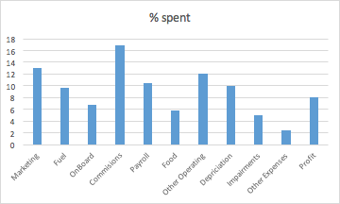
Revenue per Passenger (continued)
Profit - 8% of total passenger expenditure
13% spent on Marketing and Selling expense
Only 5.8% spent on food
16.9% spent on Commissions
Company
Customers
Competitors
Industry
Conclusion

Slide 13
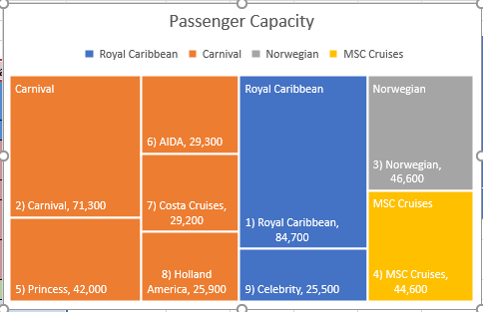
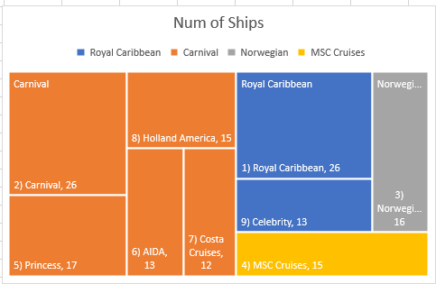

Competitors: Products, Shares, and Rankings
•The cruise industry is characterized by three large public companies (CCL, RCCL, and NCL), one large privately held company (MSC), and a host of smaller competitors.
•Following industry consolidation, these companies generally own several cruise lines beyond their namesake.
•Due to the size, scale, and experience of the ships, the larger cruise lines listed here are RCCL’s main competitors
•Most of these cruise lines compete directly with RCCL for an upper casual to premium vacation experience
•The exception would be Carnival, which brands itself “The Fun Ships” and caters to a younger, less sophisticated clientele
Company
Customers
Competitors
Industry
Conclusion

Slide 14
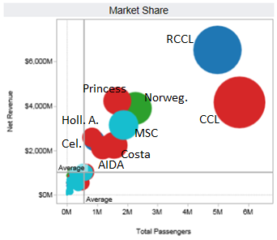
Competitors: Shares and Rankings
RCCL (corp. parent) is the second largest cruise line after Carnival Corp. (red circles) although the flagship RC cruise line has more revenue than any other line
Carnival Cruise Line has the most passengers of any single line, but its entry level clientele shows in a lower revenue per passenger than other lines
A myriad of small cruise lines, clustered in the lower left of this graph, round out the industry (light blue = all others, including MSC)
Company
Customers
Competitors
Industry
Conclusion

Slide 15
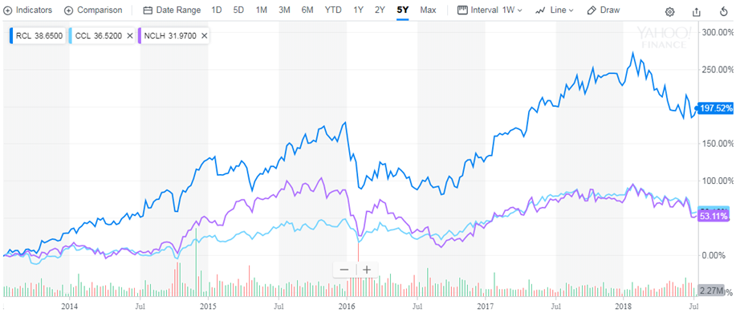
Competitors: Stock Performance
• In the past 5 years, RCL is up about 200% while CCL and NCLH are both up about 50%
Company
Customers
Competitors
Industry
Conclusion

Slide 16
Conclusion
A MAJOR player in the steadily growing Ocean Cruise industry, Royal Caribbean International has itself posted steady GROWTH and improving MARGINS, positioning itself to be a MARKET LEADER for years to come.
Company
Customers
Industry
Conclusion
Competitors

